Slide 1
Kidnet
By BIT flipping pancakes

Slide 2
Problem statement
How can we get employers to empathise, understand, and hire kidney patients who have limited education levels and mobility due to their health conditions and treatment schedule?

Slide 3
Our solution
An online platform dedicated to kidney patients
Patients can describe themselves, their skills, strengths and weaknesses, as well as their weekly dialysis schedules.
Potential recruiters can view their public profile, send them a message and include their contact details so the user can contact them for follow up

Slide 4
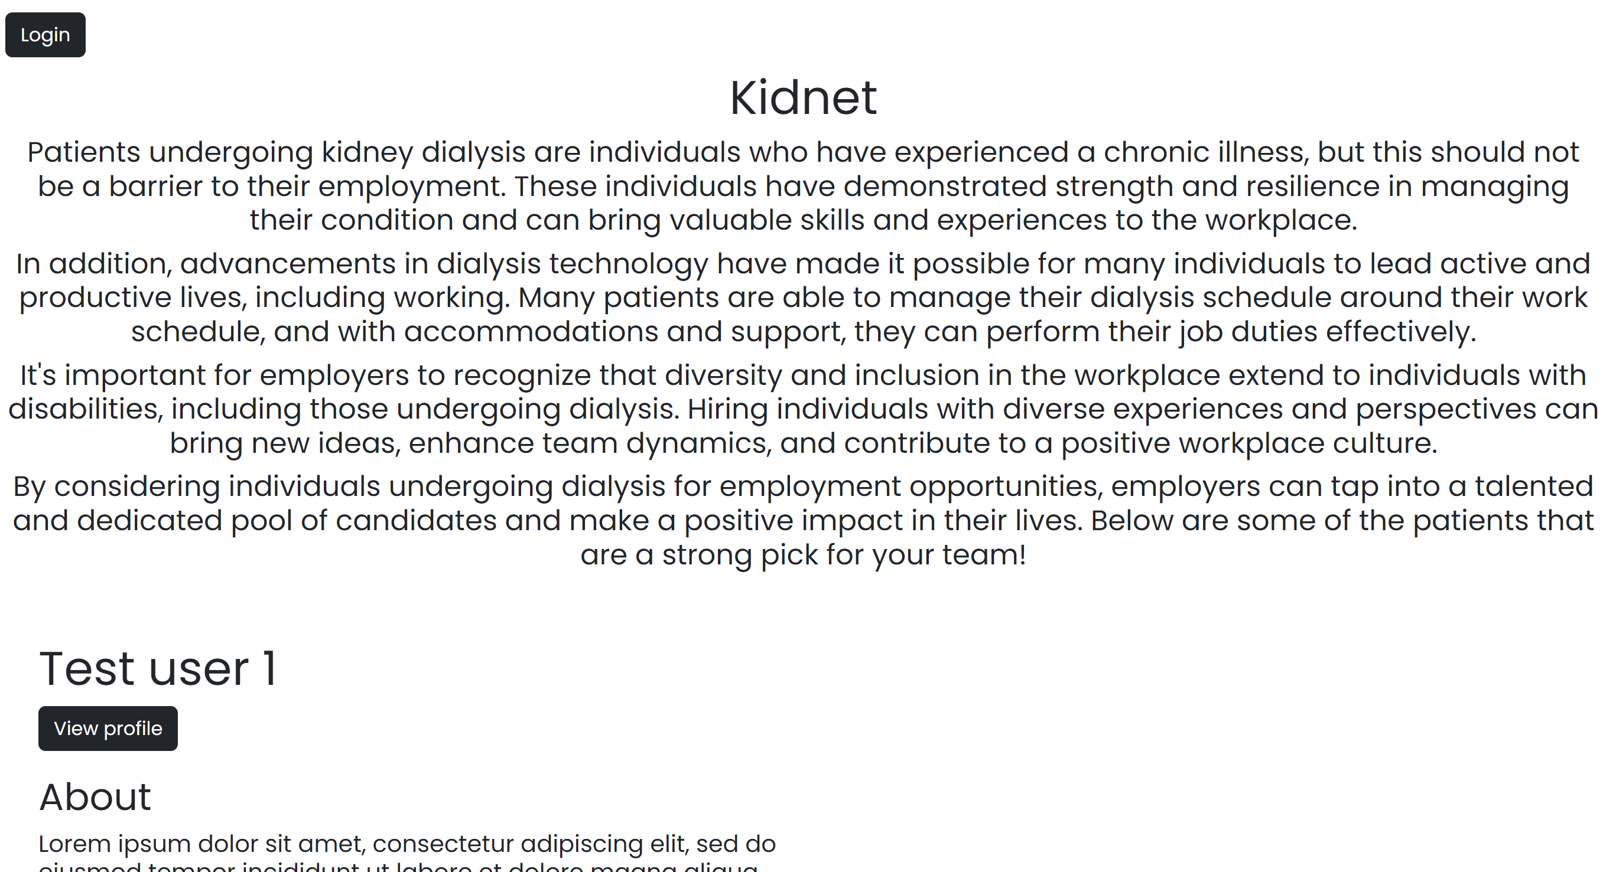
Home page with an introduction to the platform. Users are featured below for recruiters who can view their profile.

Slide 5
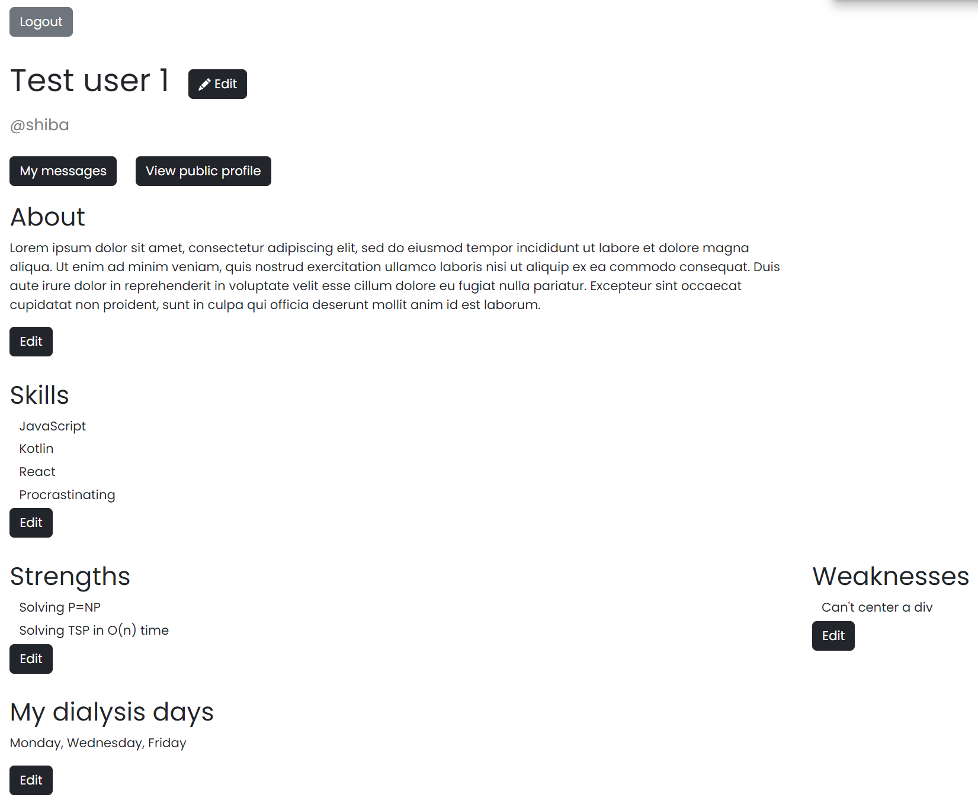
Dashboard/Profile page after login

Slide 6
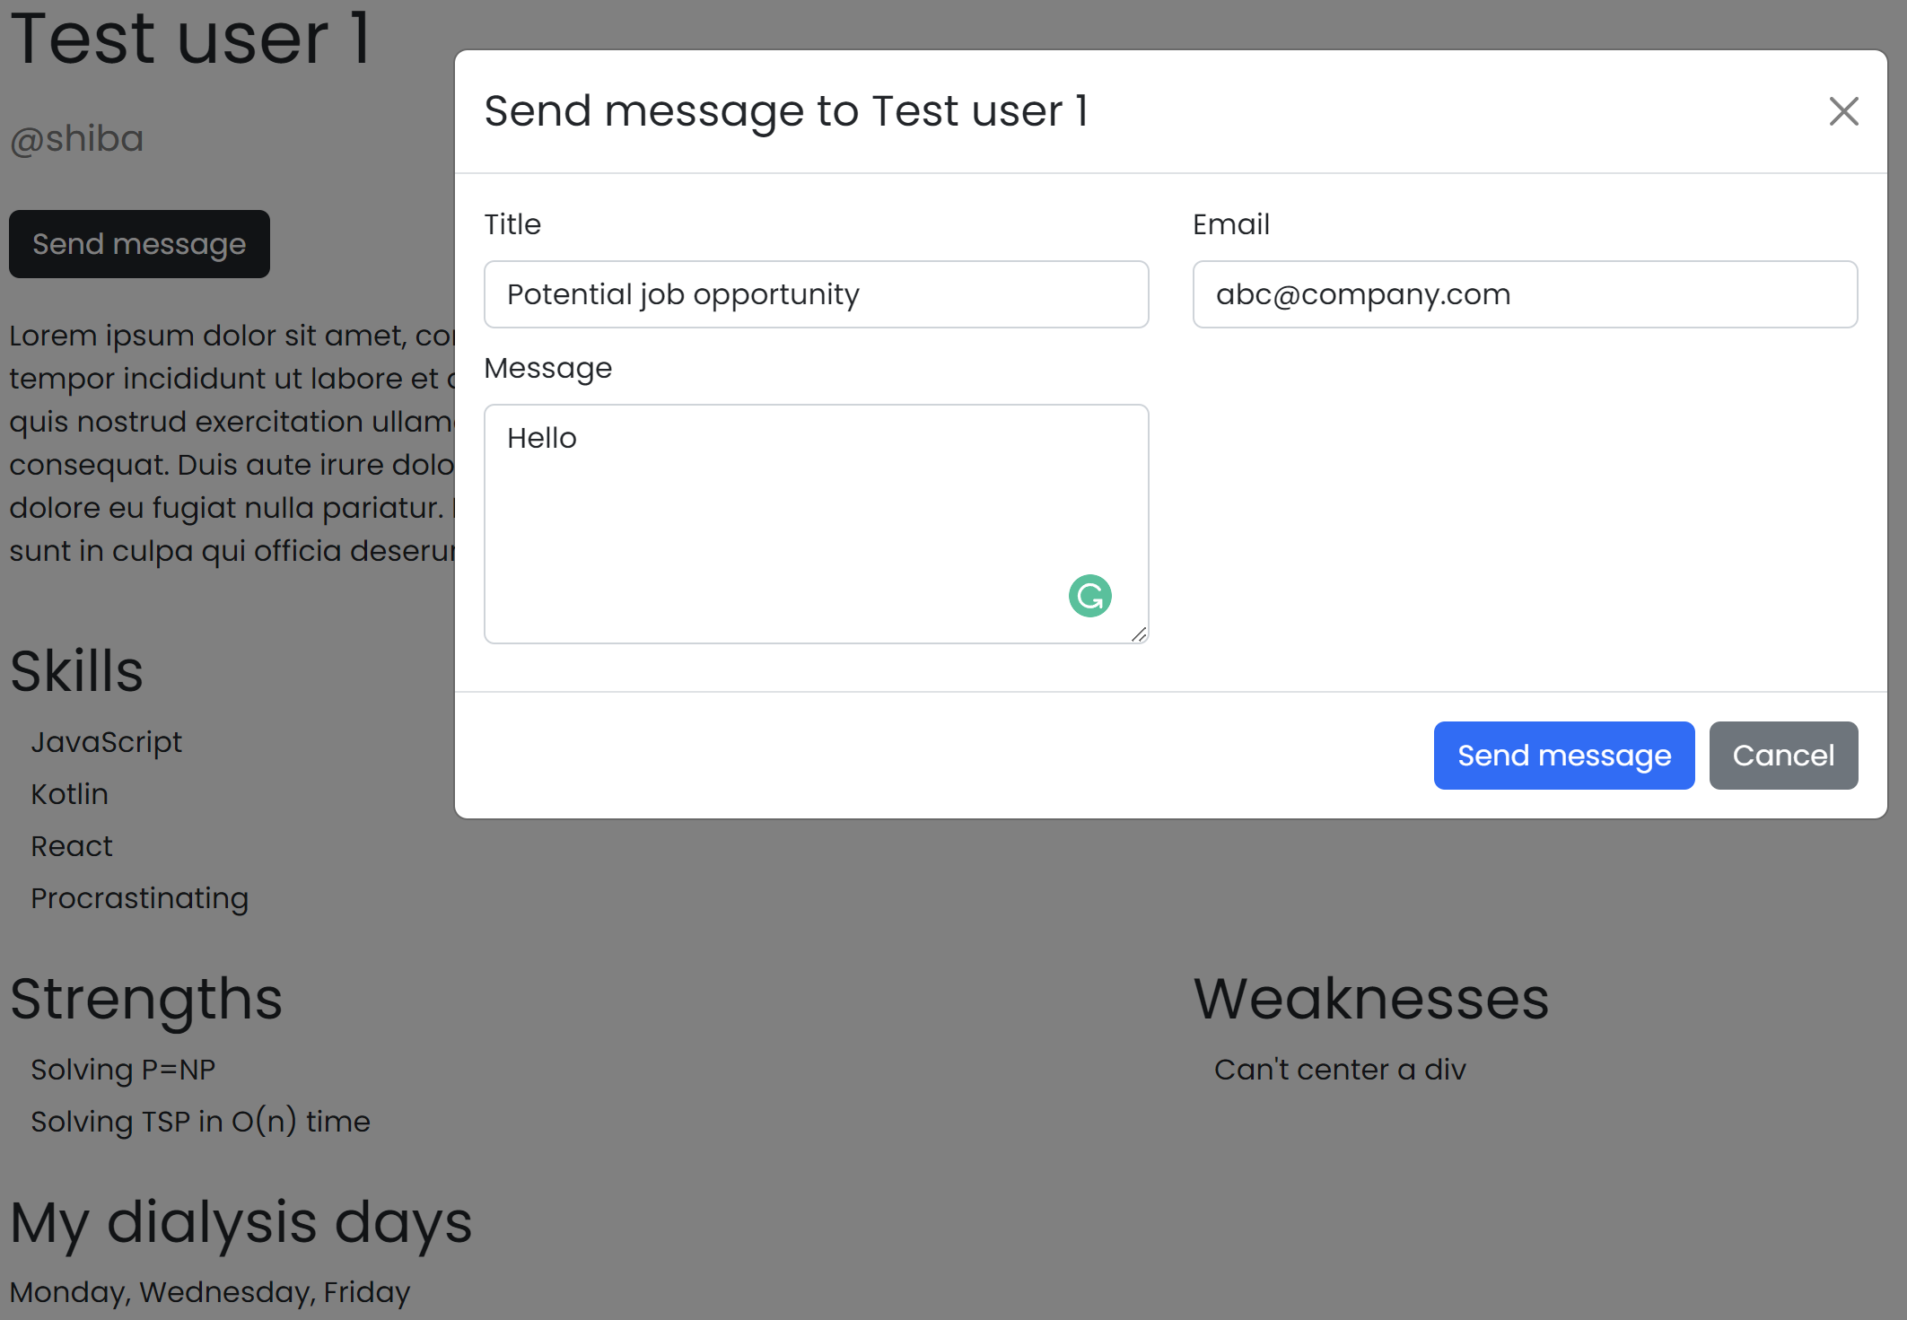
Public profile page with message functionality

Slide 7
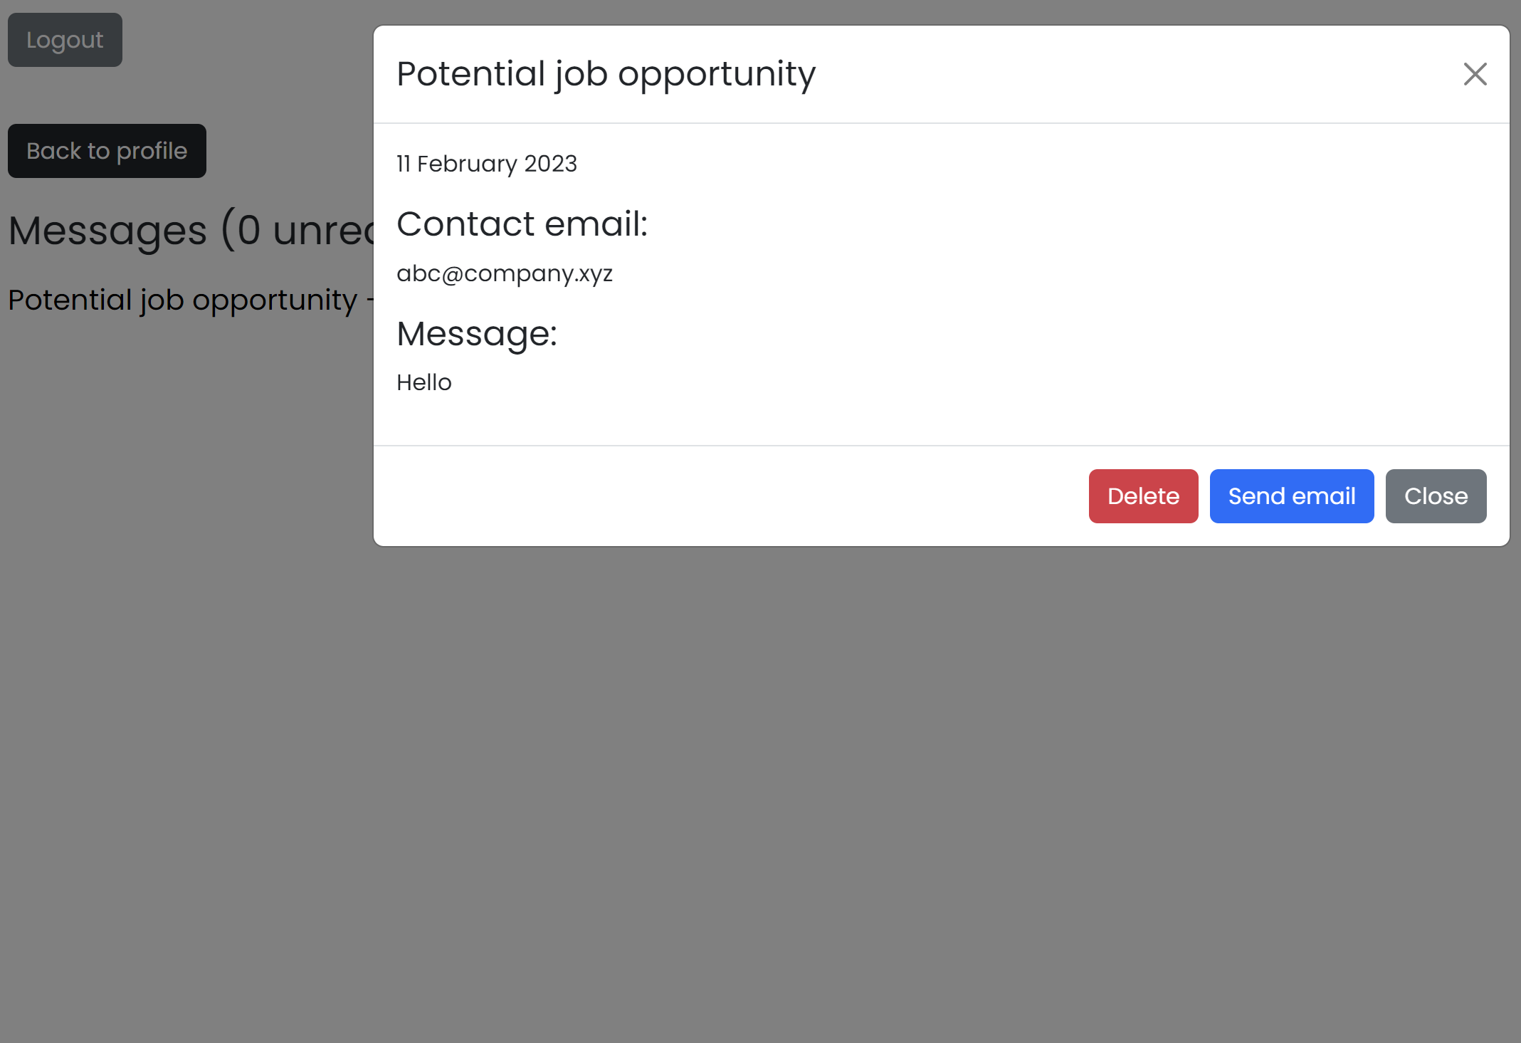
Message inbox for user

Slide 8
Why our solution?
Currently, no online platform in Singapore dedicated to help kidney patients with job opportunities
Straightforward to use, easy to setup for user
Create account, input profile details, see messages in inbox
Functionality specific for kidney patients (e.g. dialysis schedule in prototype – more can be added, refined)
Potential employers are more aware of the needs of kidney patients – dialysis schedules, mobility constraints
Take int account necessary considerations for them, aid in the company’s planning to speed up hiring process
Easy to implement – set up a backend database and server, deploy React frontend
Prototype used: MySQL + Docker for database, Node + Express for server, React frontend

Slide 9
Thank you

